Slide 1

Measuring the Effectiveness of Error Messages Designed for Novice Programmers
Guillaume Marceau
Kathi Fisler (WPI)
Shriram Krishnamurthi (Brown)
Danny Yoo (WPI/Brown, Utah)

Slide 2
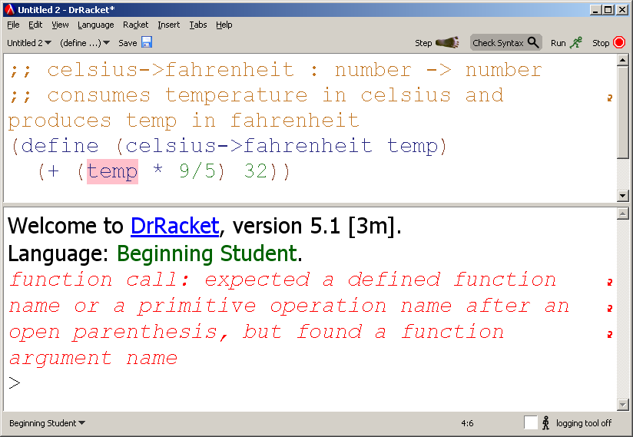
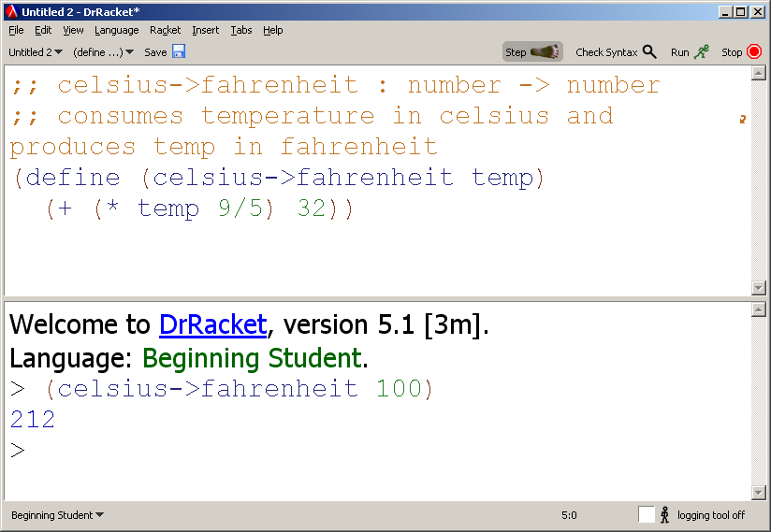
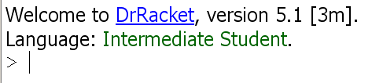

Notes:
This is DrRacket. In the top panel students write their program in a language that’s fully parenthesized with a prefix syntax. So this code is multiply the given temperature by 9/5 then add 32. When they click run they get REPL at the bottom where they can interact with their program and try their functions. If something is wrong, like here the multiply is in the middle instead of at the front, they get an error message and a highlight, that’s hopefully useful.
As you can see, it says “beginner language”. That’s because there is more than one. As Mathias was saying, there is a tower of language. Student switch to Intermediate, then to Advanced. This configure the error messages so that they only use vocabulary and only mention features the students have seen so far in class.
As for the text of the error message, they were composed with care and attention to make them as useful as possible for our student, based on our teaching experience.
But still, despite we felt was a pretty good design, we often saw our students fail to respond to the error messages in a useful way, in the lab, and in the workshop. I will give you two different examples that were not atypical of what we were seeing.

Slide 3
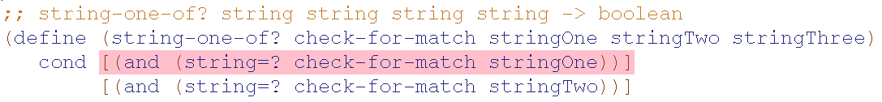
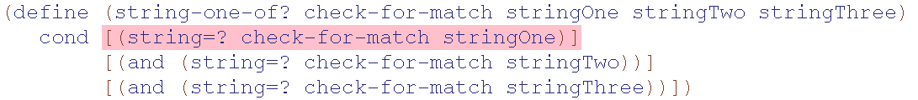
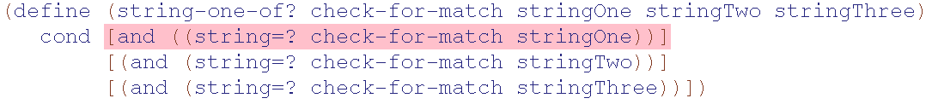
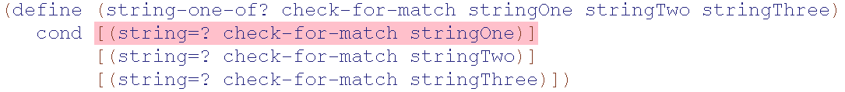
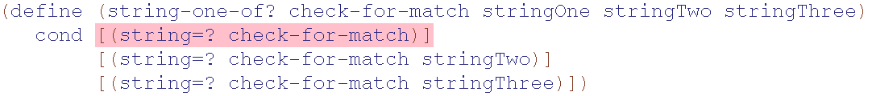
define: expected only one expression for the function body, but found at least one extra part
Notes:
Tries to fix by changing what’s in the highlight

Slide 4
How well do error messages support learning
(or fail to?)
When errors fail to teach,
in which ways do they fail?
What makes a good error message?
What is a valid metric of quality?
Can we make recommendations to the creators of pedagogical IDEs/compilers/ languages?

Slide 5
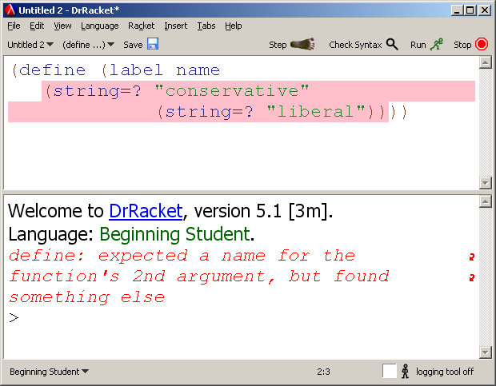
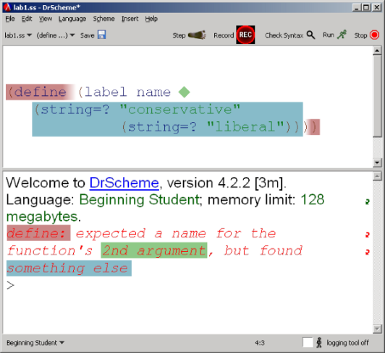
Prior Approaches to Message Effectiveness
“Were the messages helpful?”
No alternative
Did grades improve?
Too coarse
Notes:
In the related work, people have been trying to get at these questions in different way.
One thing you could do is ask the students whether they found the error messages. You will get answers of the form, “Yes! Can you imagine how hard it would have been to fix all the bug without any error messages?” This this is not a valid methodology, since the students don't have anything to compare against.
Another way would be to release a new design for the message, then check whether their exam grades went up. But this is too coarse. It can tell you whether your design is effective, but it can’t help you orient the next design iteration. We’re interested in something more fined grained.

Slide 6
= execution
= receives an error message
= keystroke
The Student’s Response to the Error Message
Notes:
Each time they ran their program, we recorded a copy of their program, recorded the error message they received, if any, and recorded every single key stroke they typed until the next execution.

Slide 7
[DEL] Deletes the problematic code wholesale.
[UNR] Unrelated to the error message, and
does not help.
[DIFF] Unrelated to the error message, but it correctly addresses a different error or makes progress in some other way
[PART] Evidence that the student has understood the error message (though perhaps not wholly,) and is trying to take an appropriate action (though perhaps not well.)
[FIX] Fixes the proximate error (though other cringing errors might remain.)

Slide 8
Rater #1
Rater #2
good
bad
good
good
bad
good
bad
good
good
good
Notes:
What we though of doing was to bring an experienced instructor that would look at the responses and make a judgment call whether the student’s edit was useful or not. That judgment is fully subjective. It draw’s on teach intuition and experience, and his impression of what the student has in mind, and what he was trying to accomplish.
When you use a subjective rubric like this in a scientific experiment, you want to get some baseline confirmation that your rating are sufficiently tangible that that two different people looking could agree on the ratings. So what you do is you bring in a second rater and you compare their responses, and you count how many times they agree. In this case they agree 4 out of the 5 times. But that would be too generous because two graders rating at random would agree 50% of the time, or more if you take into account that there are more good tags than bad tags.

Slide 9

Inter-rater agreement : κ
Rater #1
Rater #2
0.38
0.80
0.58
0.58
Expected Agreement = 0.70² + 0.30²
= 0.58
perfect agreement
eq. to chance
0.38
0.84
worse than chance
slight fair moderate substantial excellent
0.0
0.20
0.40
0.60
0.80
1.0
Notes:
There is a tool in social sciences called the test of inter-rater agreement, or kappa. What Kappa does is it factors out of the agreement the proportion that could have been gotten by chance. The formula is the agreement minus the expected agreement, over 1 – the expected agreement.
So in this case, the agreement is 0.80, or 4 out of 5. The expected agreement is the probability of getting two goods, there are 7 out of 10 good tags, so 0.70 squared, plus the probability of two bads, 0.30 squared. So the expected agreement is 0.58. Put that in the formula, and so kappa is equal to 0.38.
By convention, kappa of 0.38 it’s called a “fair agreement”. If you are trying to publish in a social science journal, it takes a kappa of 0.60 or 0.80 to get published, depending on what research you’re doing.
Kappa of zero means there was as much agreement as would expect by chance alone. Kappa less than zero means an agreement worse than change, which doesn’t happen very often. Kappa of 1 mean perfect agreement.
The rubric I’m going to present on the next slide went through many different versions. Each time we would grade a bit, test using kappa, fail to get a good agreement, then revise and improve the rubric, then test with kappa again, and so on. It took six different versions before we finally reached kappa of 0.84.

Slide 10
#error × %error × %bad = #bad
Notes:
I’m going to show you the results of the next slide. I’ll explain how to read them on the Lab #1 results.
The way to read this is, during lab #1, a student saw 8.5 error messages, on average. The first column shows how the error messages distribute across the nine most common error message categories. There are few categories not shown, they are really rare.
The second column is the result of our grading, and the last column is an estimate of how many bad errors of each category the students did. This is just one multiply by the other multiplied by the other. The blue bar is just a chart of the third column. So this means that a students responded badly to 3.1 message out of the 8.5 error messages they saw during lab #1.

Slide 11
Vocabulary difficulties
n-ary tree
Difficult structure accessor names
Notes:
These are the results for the entire course. As you would expect, students get better at answering messages over time, except for Lab #2 where students who are still struggling with the syntax of define right get overwhelmed more difficulties.
But that’s not the point. I’m not here to talk about my course. The point is that you can make your own table like this. You probably want to make your own table like this. This table might the end of the analysis, it’s also the beginning of a reflection on the course and on the error messages.
For example, in our case, I’ve put black rectangle around the 10 most problematic instances. And we looked at each one of them to find out what might have been the source of the difficulty.
In Lab #1, we traced that down to an issue with the vocabulary that the error messages uses that the students can’t quite understand.
The bump in Lab #5 come from the fact that this is the lab where students get to practice n-ary trees, and student struggle to write down these fairly complicated trees, where you have a node that contains a list the contains a node and so forth, and student would lose track of the nesting.
And in Lab #6, the bump unbound IDs isn’t because students suddenly become bad typists. Rather, we traced that down to a pair of structure definitions in the worksheet that had confusing and inconsistent field names, and students kept getting them wrong.

Slide 12
Reflection
Rubric identifies pain points
Identifying fix needs deeper evaluation
Curriculum Error Messages
Notes:
The point is that applying the rubric is a powerful way of identifying the pain points in the course. And this set up an investigation of what might be causing these difficulties. And what we realized is that pain points occur when a difficulty in the curriculum meets an error message that's not helping as much as it could. And from there you can try to determine how the situation can be ameliorated, by some combination of change in the curriculum or in the error messages.

Slide 13
For the Community
Look at fine-grained edits
Gather around a common rubric
Notes:
To conclude, I would like to say, we need a lot more work that looks at fine-grained edits. There is a well of interesting data there that we really could afford to investigate more.
and it would be really interesting if the community could gather around a common rubric. There are a lot of really interesting questions that we as a community could be pursuing if we worked with a common rubric. For instance, I had this discussion earlier today one whether it’s preferable to teach using a static type system, or dynamic types. We can argue all day, but using a common rubric would make it possible to get real traction into the question. Without saying our rubric is the be-all-end-all of rubric, we are proposing that our rubric could serve this role. But the important point is to enable comparison with a common rubric.

Slide 14
Interviews
Four interviews
One hour long each
Done around the midterm
Average-to-good students

Slide 15
Observation From Interviews
1 of 2

Slide 16
Interviewer: The error message says “the function body.”
Do you know what “function body” means?
Student: Nah, the input, everything that serves as a piece of input?
Interviewer: Actually, it's this. When DrScheme says “function body” it means this part.
Student: Oh man! I didn't…
[The student proceeds to fix the error successfully]

Slide 17
What DrRacket Says:
define: expected only one expression for the function body, but found at least one extra part.

Slide 18
What the Student Sees:
define: expected only one thingamabob for the geewhiz’s whosiewhatsit, but found one extra whatchamacallit.

Slide 19
Circle an identifier in this program
(define (celsius->fahrenheit temp)
(+ (* temp 9/5) 32))
RIGHT
WRONG
Notes:
Want to see whether students can identify instances of terminology in source code. Here’s a simple example problem.

Slide 20
Circle one instance of each vocabulary term in the code below
Vocabulary term Sample usage
Q1. Argument >: expects at least 2 arguments, given 1
Q2. Selector this selector expects 1 argument, here it is provided 0 arguments
Q3. Procedure this procedure expects 2 arguments, here it is provided 0 arguments
Q4. Expression expected at least two expressions after `and', but found only one expression
Q5. Predicate this predicate expects 1 argument, here it is provided 2 arguments
;; (make-book number string string number number bst bst)
(define-struct book (isbn title author year copies left right))
;; this-edition?: bst number number -> boolean
;; Consumes a binary search tree, an ISBN number, and a year, and produces true
;; if the book with the given ISBN number was published in the given year
(define (this-edition? a-bst isbn-num year)
(cond [(symbol? a-bst) false]
[(book? a-bst)
(cond [(= isbn-num (book-isbn a-bst))
(= year (book-year a-bst))]
[(< isbn-num (book-isbn a-bst))
(this-edition? (book-left a-bst) isbn-num year)]
[else (this-edition? (book-right a-bst) isbn-num year)])]))
Notes:
Here’s the full quiz. Note that code is larger (more expressions to choose from), giving multiple words, supplying sample usage for context

Slide 21
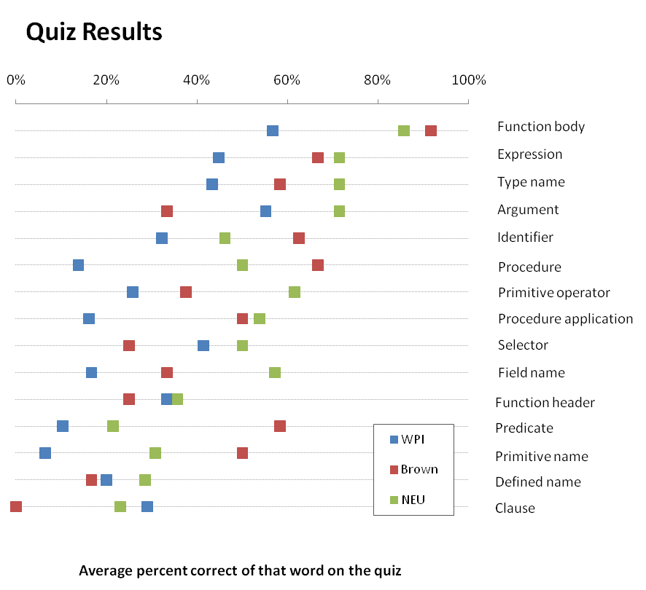
< 50%

Slide 22
Serendipitous Controlled Trials
Brown NEU WPI
Primitive name 
Procedure 
Primitive operator 
Field name 
Procedure application  
Predicate  
Defined name 
Type name 
Identifier  
Function body  
Function header  
Argument   
Clause   
Expression   
Selector   
 = Used in Class

Slide 23
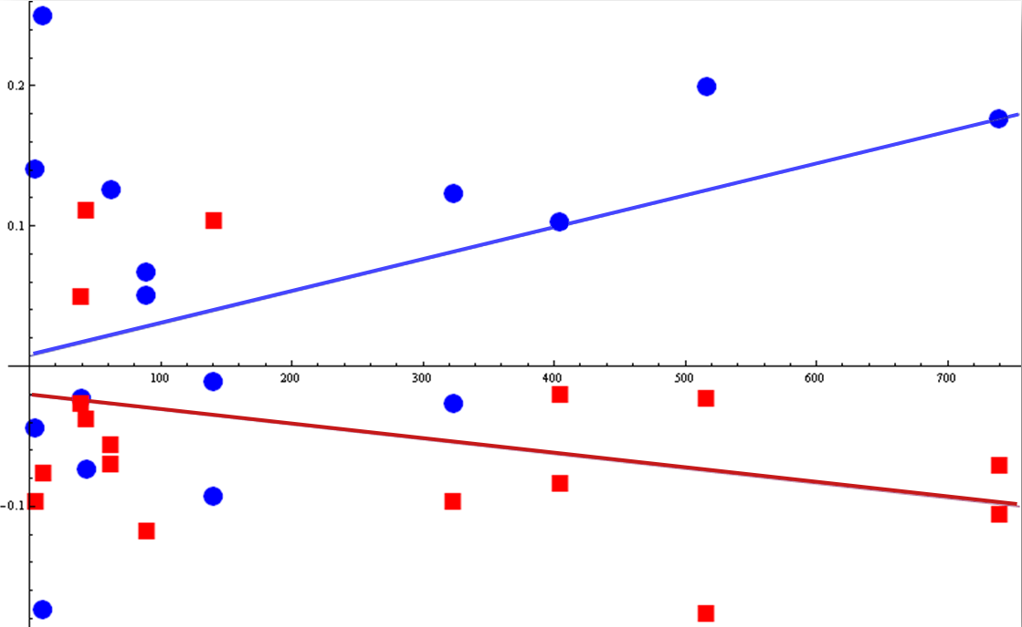
Quiz score residual
(after factoring out word difficulty and university strength)
Number of times the word was presented to a student in an error message (WPI)
Words
used in class
Words NOT
used in class

Slide 24
For words used in class:
more exposure in error messages ➔ better quiz scores
p = 0.034
(which is statistically significant at the 0.05 level)
For words not used in class:
more exposure in error messages ➔ worse quiz scores
Words
used in class
Words NOT
used in class

Slide 25
Old term | New term
Procedure Primitive name Primitive operator Predicate Selector Constructor | Function
Name Identifier Argument Defined name | Variable, argument (“argument” is reserved for actual arguments in function calls)
Sequence | At least one
Structure type name | Structure name
Question—answer clause | A clause is expected to have a question and an answer
Function header Keyword Type < > ‘ ’ | These words and notations are removed entirely and reworded in terms of other vocabulary words.
Function body Expression Field name Type name Top level Binding Clause Part | These words stay unchanged
Notes:
Colapse vocab, abandon subtle distinctions of meaning that aren’t useful at this level.
Remove technical vocab when English equivalent are available.
Align with the vocab of algebra when possible.

Slide 26
Observation From Interviews
2 of 2

Slide 27
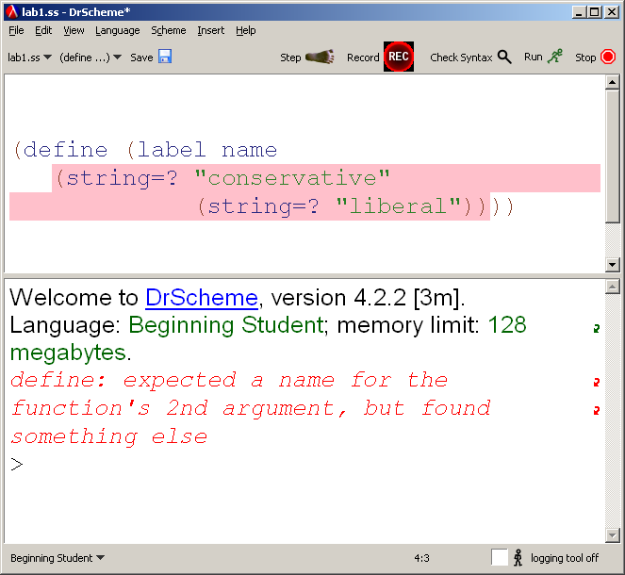
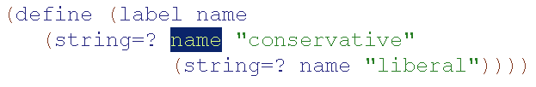
Interviewer: When you get these highlights, what do they mean to you?
Student #1: The problem is between here and here, fix the problem between these two bars.

Slide 28
DrRacket’s Highlight Semantics
This expression contains the error
The parser didn’t expect to find this
The parser expected to see something after this, but nothing is there
This parenthesis is unmatched
This expression is inconsistent with another part of the code

Slide 29
Summary of Findings
Error messages need to explicate the meaning of the highlight.
Students need an avenue through which they will learn the vocabulary.
Error messages are hard to get right;
user studies are important.

Slide 30
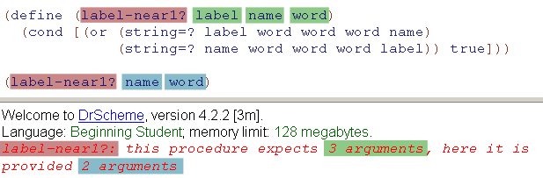
Read  Understand  Formulate
[FIX] Fixes the proximate error (though other cringing errors might remain.)
[PART] Evidence that the student has understood the error message (though perhaps not wholly,) and is trying to take an appropriate action (though perhaps not well.)
[UNR] Edit unrelated to the error message, and does not help.
[DEL] Deletes the problematic code wholesale.
[DIFF] Edit unrelated to the error message, but it correctly addresses a different error or makes progress in some other way.
n-ary tree
good
bad
good
good
bad
Kathi Fisler (WPI)
Shriram Krishnamurthi (Brown)
kfisler@cs.wpi.edu
sk@cs.brown.edu
Notes:
Thank for very much.

